Slide 1
Global Economic and Demographic Trends Analysis (1960–2016)
Name: Cheran T
Batch: DADS-March_2025

Slide 2
OBJECTIVE
To analyze global economic, demographic, and health indicators from 1960 to 2016 using SQL and Excel data sources in Power BI, and deliver actionable insights through interactive dashboards focusing on population trends, GDP per capita, literacy rates, and infant mortality across regions and countries.
STEPS TO FOLLOW
Data Cleaning and Transformation
Descriptive Statistical Analysis
DAX Calculations
Data Visualizations
Key Insights and Analysis

Slide 3
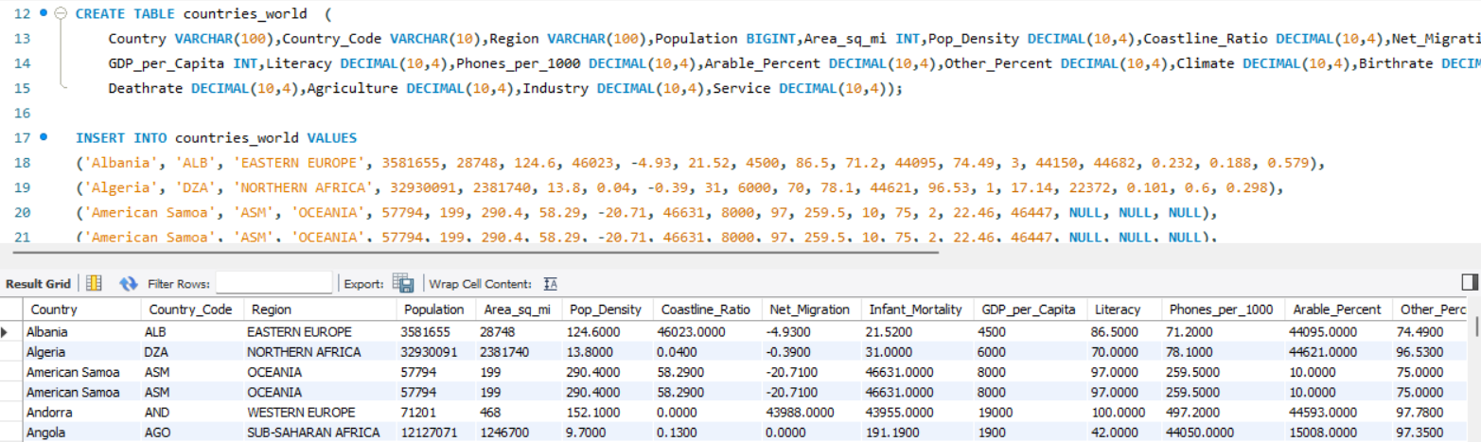
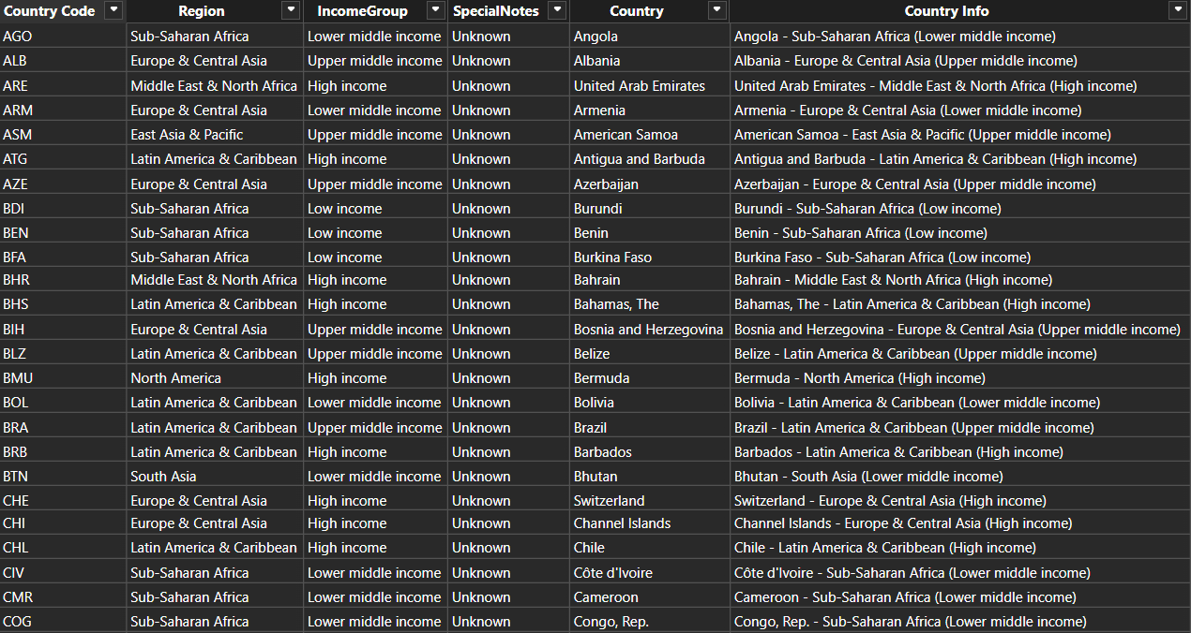
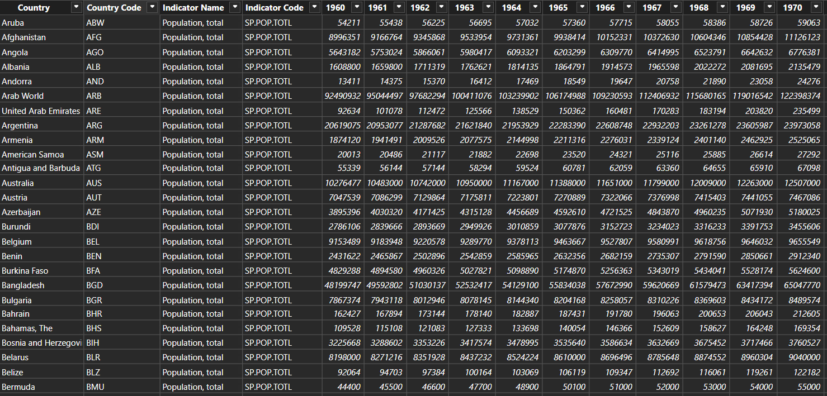
DATASET OVERVIEW

Slide 4
Importing Datasets
Imported SQL dataset: Using SQL connector and from 'Get Data' - MySQL Database - (Select file) – Connect
Imported CSV file: 'Get Data' - Text/CSV - Select file – Import
Imported Excel Worksheet: 'Get Data' - Excel Workbook - Select file and particular sheets needed - Import
Cleaning Datasets
Handling the Null value and Blank rows
Standardizing column names and changing the column types to the right ones
Remove the duplicate rows and columns

Slide 5
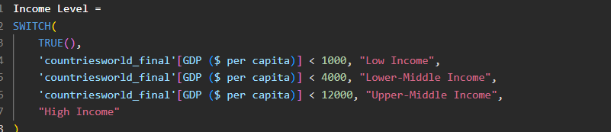
DAX Formula And Descriptive Statistics Calculation

Slide 6
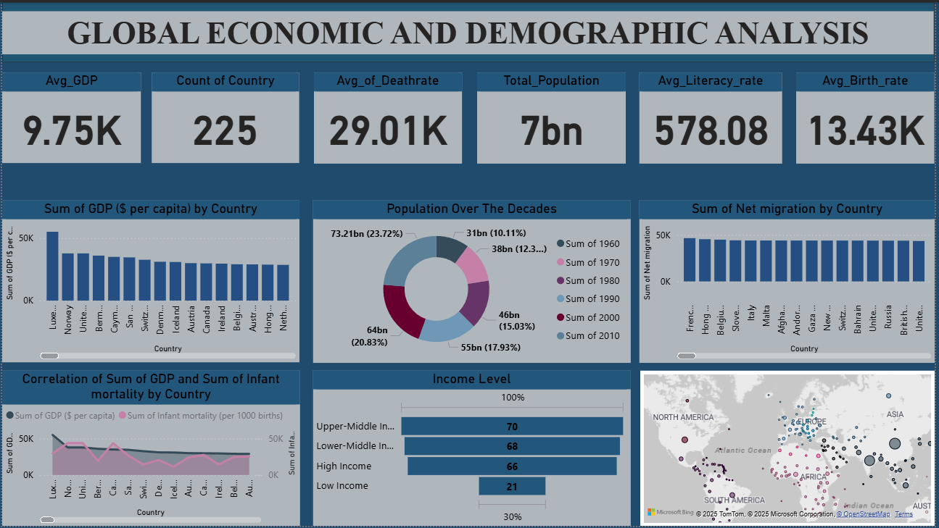
DASHBOARD

Slide 7
Finding and Insight
The global population has significantly increased from 1960 to 2020
Countries with the highest populations include China, India, and the United States, showing consistent growth since 1960.
The United States leads with the highest GDP, significantly influencing the global economy.
Low-income countries show minimal GDP, indicating economic disparities.
High-income countries have a greater share of GDP from services, while low-income countries rely more on agriculture.
Infant mortality is drastically higher in low-GDP, low-literacy countries.
Highest literacy rates are found in Northern and Western Europe, North America, and East Asia.
Countries investing more in services and education show better GDP and health indicators.

Slide 8
Conclusions
Focus on policy & investments in low-income countries to reduce disparity
Strengthen global partnerships to support weaker economies
Strengthen Investment in Education and Healthcare Infrastructure
Control Population Growth in Rapidly Growing Regions
Enhance Data Monitoring and Policy Alignment

Slide 9
THANK YOU ALL

